Slide 1
LOGISTIC
REGRESSION
Credit-risk modelling: predicting loan default
Presented by Jaun Minnaar
MODEL DEVELOPMENT • DIAGNOSTICS • PERFORMANCE

Slide 2
The problem we want to solve
Estimate the probability that a borrower will default.
INPUTS
Income • loan amount • utilisation • DTI • employment • Interest rate
Use borrower and loan characteristics as predictors.
Support more consistent, evidence-based lending decisions.
MODEL
Evaluate performance on data not used to fit the model.
Logistic regression estimates a default probability between 0 and 1.
DECISION
A lending decision also depends on a chosen risk threshold and business costs.
01 | OBJECTIVE
02

Slide 3
The data
The model uses historical loan records with a binary outcome.
TARGET
NUMERIC PREDICTORS
CATEGORICAL PREDICTORS
Default
0 = did not default
1 = default
Examples: income, loan amount, utilisation, debt-to-income ratio and age/history variables.
Examples: employment status and other borrower/loan categories.
02 | DATASET
03

Slide 4
Final model specification
The model estimates default probability from four retained predictors:
Logit(P) = -3.8752 - 0.4656D₁ - 0.0819D₂ - 0.0103D₃ + 0.0974C + 0.0134B + 0.7794A
Symbol | Meaning
A | DTI
B | Utilisation
C | Interest rate
D₁ | Employment status (Salaried)
D₂ | Employment status (Unemployed)
D₃ | Employment status (Self-employed)
INTERPRETATION
We can see DTI has the strongest influence on the default rate, followed by the employment status, interest rate, and utilisation
OUTPUT
Estimated probability of default
LINK FUNCTION
The logit link maps linear predictors to probabilities
03 | SELECTED MODEL
04
Notes:
• Why do unemployed people show a bigger decrease in default rate than self-employed people:
Unemployed people are not approved for loans based on income because they either have no income or a small, inconsistent income. Thus, loans for unemployed people are most often secured loans, meaning the loan is backed by collateral, and more is at stake for the borrower if they default.

Slide 5
How the model was developed
1
Fit a full model
2
Investigate transformations
Start with the candidate predictors.
Income and loan amount were log-transformed after initial insignificance.
3
Check diagnostics
4
Simplify the model
Review calibration, multicollinearity, influence and linearity in the logit.
Remove redundant/insignificant terms and compare nested models.
04 | MODEL SELECTION
05

Slide 6
Candidate model
H0: β=0 vs Ha: β≠0 | Test statistic (χ²) | p-value | Reject/Do not Reject H0 | Significant/Insignificant
Intercept | 36.41367854421724 | 1.5957935273320792e-09 | Reject H0 | Significance
Education | 5.761777313754828 | 0.2176592539770914 | Do not Reject H0 | Insignificance
Offences | 222.227284406167 | 6.625800201615375e-48 | Reject H0 | Significance
Income | 1.631190093397892 | 0.44237601464023324 | Do not Reject H0 | Insignificance
DTI | 28.965216124489228 | 2.2774364300233987e-06 | Reject H0 | Significance
LoanAmt | 0.47206296869498093 | 0.49203963431266307 | Do not Reject H0 | Insignificance
HistLen | 2.1614556512608503 | 0.141510577160578 | Do not Reject H0 | Insignificance
Utilisation | 118.01148892862618 | 1.723865891721587e-27 | Reject H0 | Significance
Age | 2.912413075269317 | 0.08790026619483597 | Do not Reject H0 | Insignificance
EmpStatus | 2.2663026369190313 | 0.13221499874044434 | Do not Reject H0 | Insignificance
HomeOwn | 9.620626813111903 | 0.0019240405390582196 | Reject H0 | Significance
Purpose | 0.10306390374690408 | 0.7481833569307919 | Do not Reject H0 | Insignificance
α = 0.05
Notes:
We did not remove the insignificant variables directly. Firstly, we transformed variables and removed multicollinearity. Afterwards, we rechecked the results to see if the significance of the variables might have changed because of this. Only after all those steps did we remove insignificant variables.

Slide 7
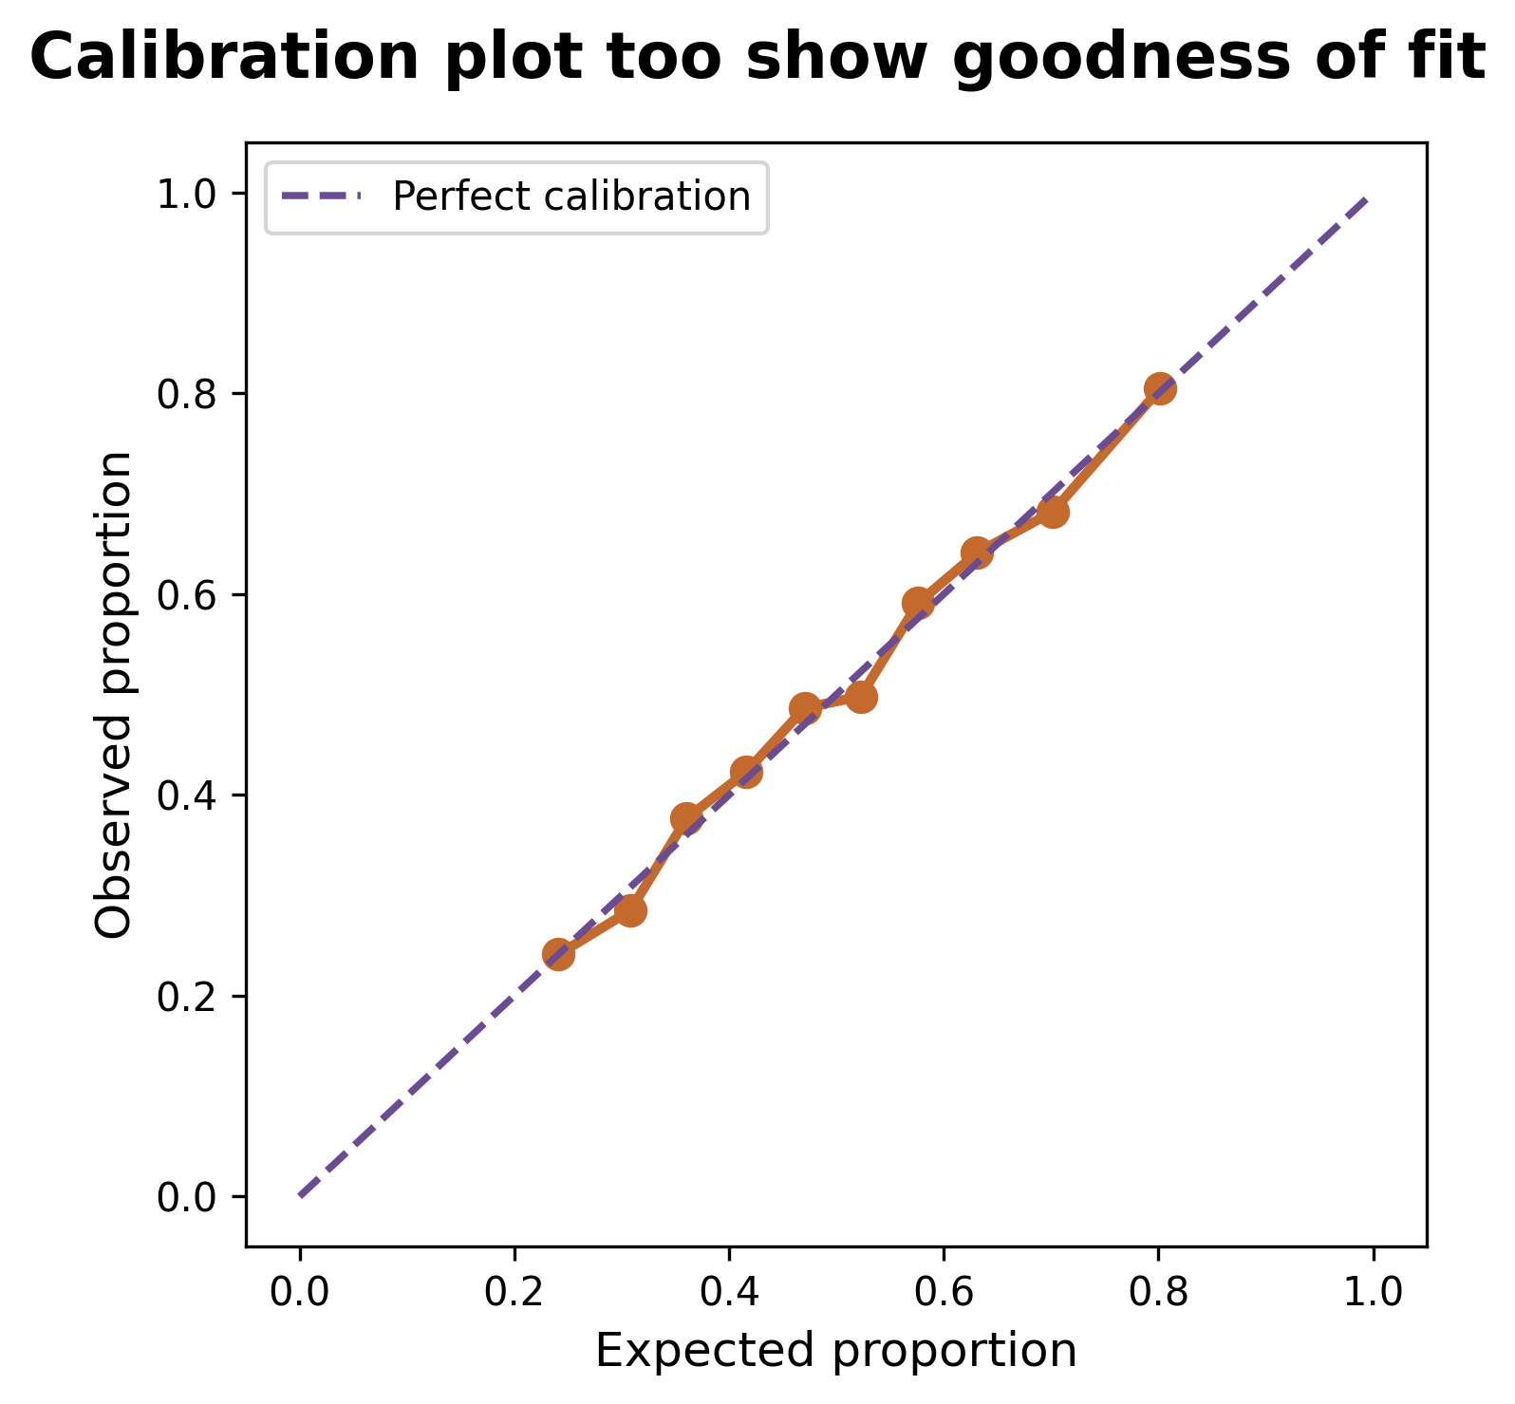
Calibration: do predicted risks match outcomes?
Calibration assesses whether predicted probabilities match observed default rates.
Likelihood-ratio test:
H₀: Shows discrimination vs. H_{A}: No evidence of discrimination
p-value ~ 0, which means we reject H_{0,} and thus there is no evidence of discrimination
,
Hosmer–Lemeshow test:
H₀: The model is well calibrated vs. H_{A}: The model is not well calibrated
p-value = 0.4078, which means we do not reject H_{0,} and thus there is no evidence of poor calibration
This, in essence, shows us a well-calibrated model
The calibration plot shows that there is no evidence of discrimination in the model
05 | DIAGNOSTICS
06

Slide 8
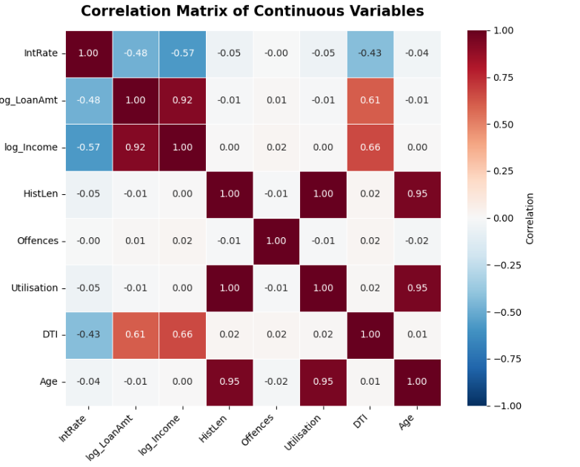
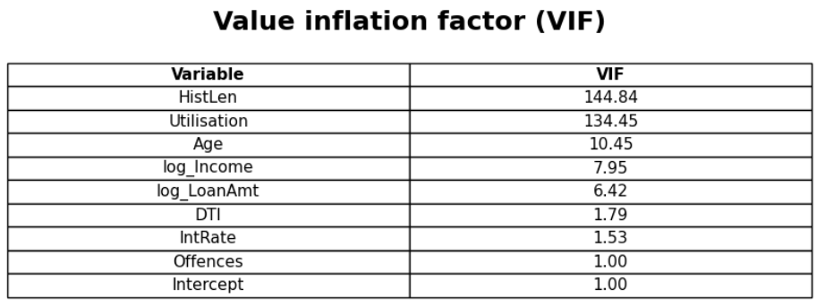
Multicollinearity
The correlation review highlighted:
Age, history length and utilisation were strongly correlated.
Income and loan amount were strongly correlated.
What I did in response: remove redundant predictors or engineer a defensible ratio, such as the loan-to-income ratio based on the ones with the highest VIF.
06 | DIAGNOSTICS
07

Slide 9
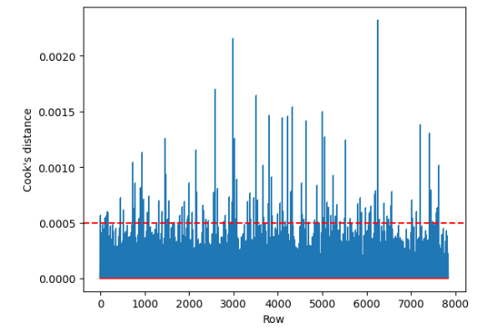
Influential observations
Cook’s distance was used to flag observations that may influence the fitted model.
WHAT THE PLOT CAN SHOW
Potentially influential cases—not automatically erroneous records.
WHAT WAS DONE
Flagged observations were retained because the comparison did not show a meaningful difference.
Best practice: investigate flagged cases and report a sensitivity analysis with and without them.
07 | DIAGNOSTICS
08

Slide 10
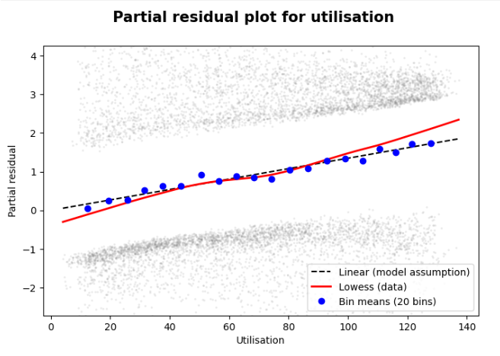
Linearity in the logit
Logistic regression assumes a linear relationship between each continuous predictor and the log-odds, unless modelled otherwise.
Utilisation showed possible non-linearity, with a p-value of 0.0134
A partial-residual plot was reviewed.
The fitted trend appeared close to the reference line, supporting—but not proving—the linearity assumption.
If needed, test splines or nonlinear terms and compare validation performance.
08 | DIAGNOSTICS
09

Slide 11
Choosing the simpler model
Full model
Simplified model
Contains the candidate predictors and serves as a comparison baseline.
COMPARE
Retains the selected predictors after significance and diagnostic checks.
The comparison found no statistically significant difference in fit.
Interpret this as insufficient evidence that the larger model fits better—not proof that both models are identical. Prefer the simpler model if performance and diagnostics remain acceptable.
09 | MODEL SELECTION
10

Slide 12
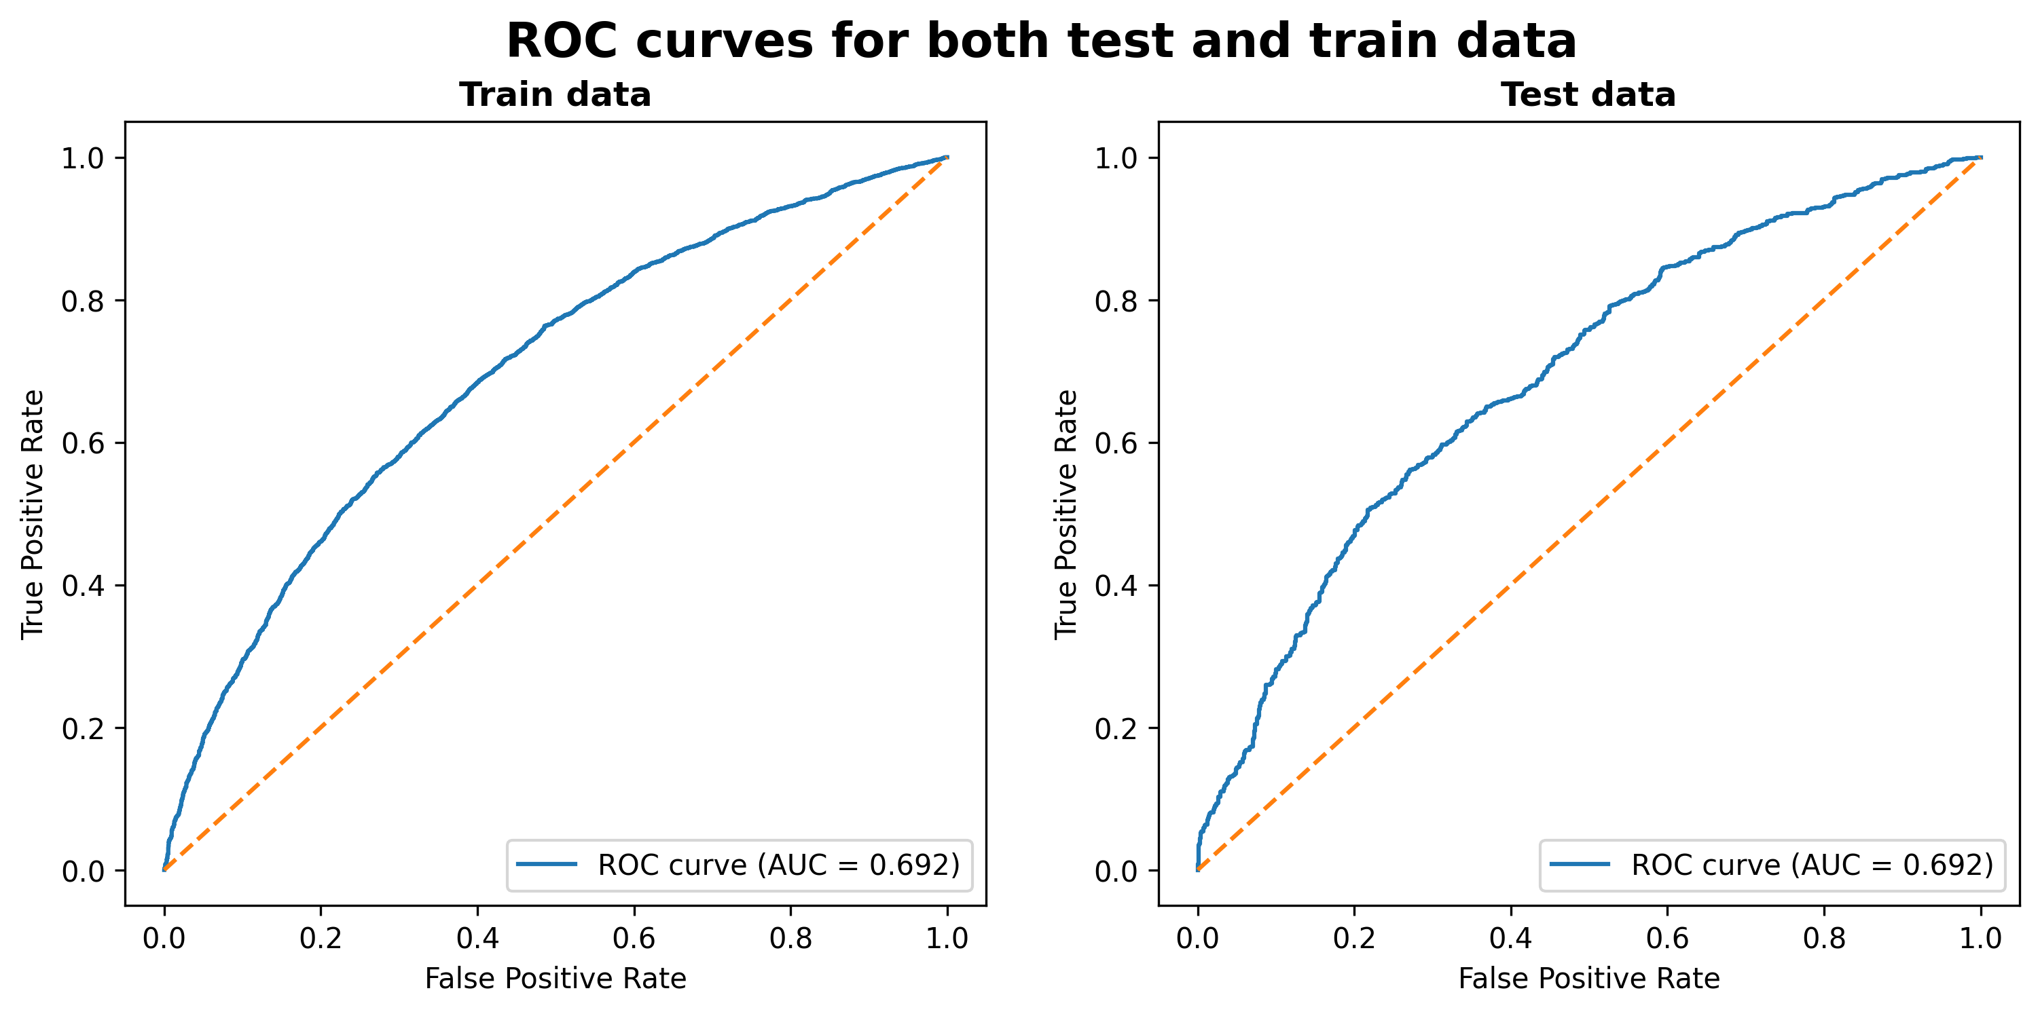
Discrimination: ROC curve and AUC
AUC measures how well the model ranks defaulters above non-defaulters.
TRAIN AUC
0.695
TEST AUC
0.692
Similar train/test AUC suggests little apparent performance gap; AUC around 0.69 indicates modest discrimination.
10 | PERFORMANCE
11
Notes:
The AUC shows a weak model. This might be because the data were modelled with a tree structure rather than a linear structure. The next step is to build 2 different models for top earners and lower earners to reduce the bimodality seen in the Debt-to-Income ratio data.

Slide 13
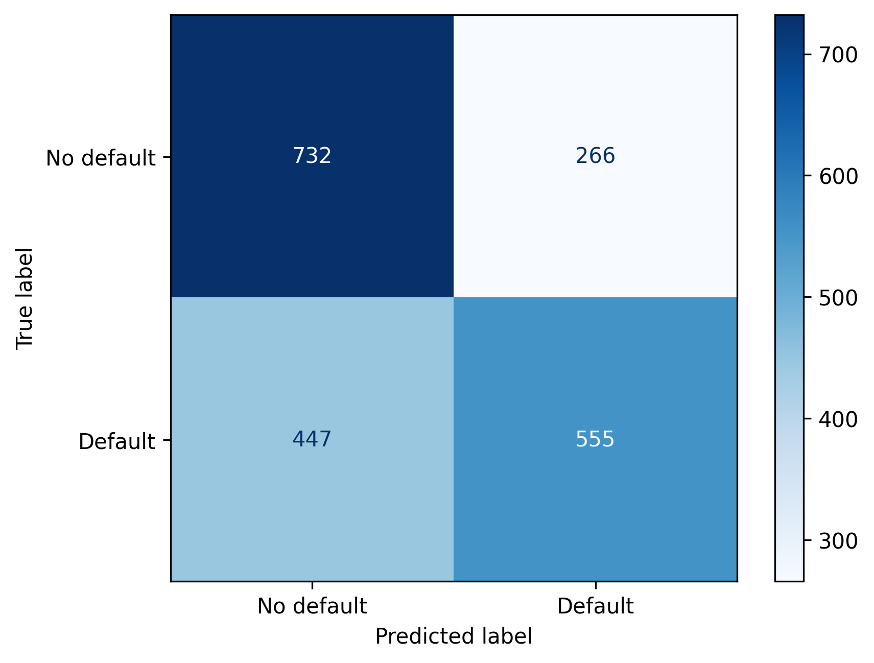
Confusion matrix
At the selected classification threshold, compare predicted classes with actual outcomes.
The matrix depends on the chosen threshold and the class balance in the test set.
11 | PERFORMANCE
12
Notes:
False positives are more dangerous in this case than false negatives as this will cost the bank money, whereas a false negative will just mean the loan is not granted, leading to much less loss for the bank.

Slide 14
Performance metrics
Metric
Train
Test
What it tells us
Accuracy
0.642
0.644
Overall proportion classified correctly
Sensitivity
0.557
0.554
Share of actual defaults detected
Specificity
0.728
0.733
Share of non-defaults identified
Precision
0.675
0.676
Share of predicted defaults that were defaults
F1 score
0.610
0.609
Balance of precision and sensitivity
Train and test metrics are very similar. Sensitivity is relatively low, so many defaults may be missed at this threshold.
12 | PERFORMANCE
13
Notes:
We have a low variation but a high bias. Thus, the variance-bias trade-off holds.

Slide 15
Conclusion
The model is stable across train and test data, but its predictive power is limited.
WHAT WORKS
MAIN LIMITATION
NEXT STEP
Similar train/test performance
AUC ≈ 0.69; sensitivity ≈ 0.55
Compare alternative models on the same held-out data
Use a consistent validation strategy, tune the decision threshold to the costs of false positives/negatives, and assess calibration before deployment.
THANK YOU

